Slide 1
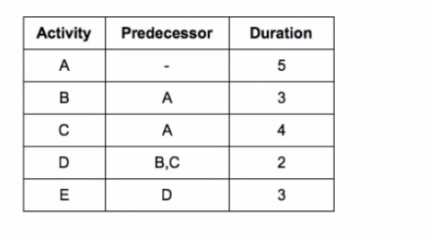

Slide 2
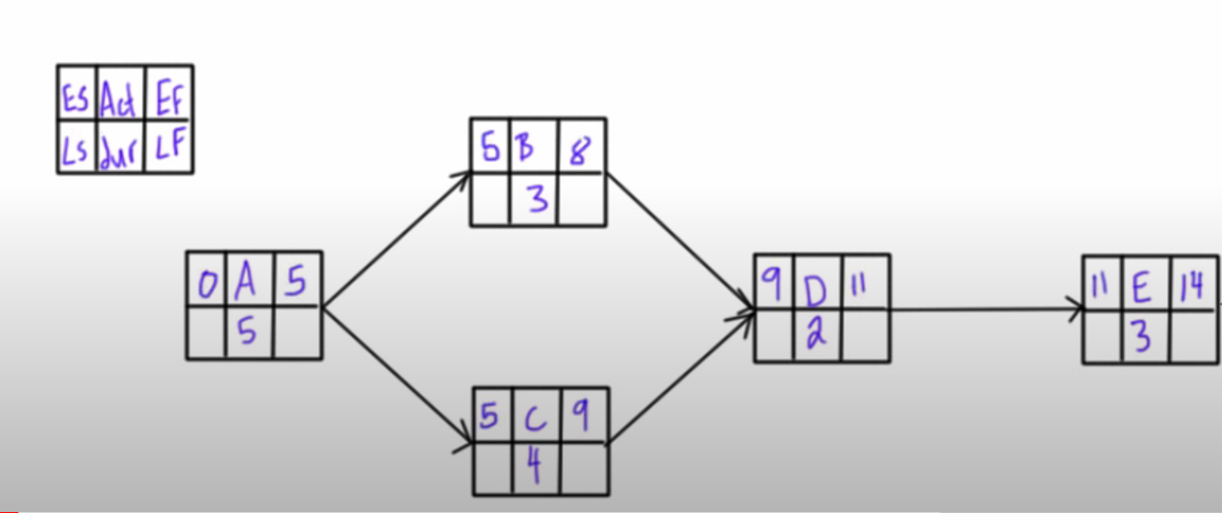

Slide 3
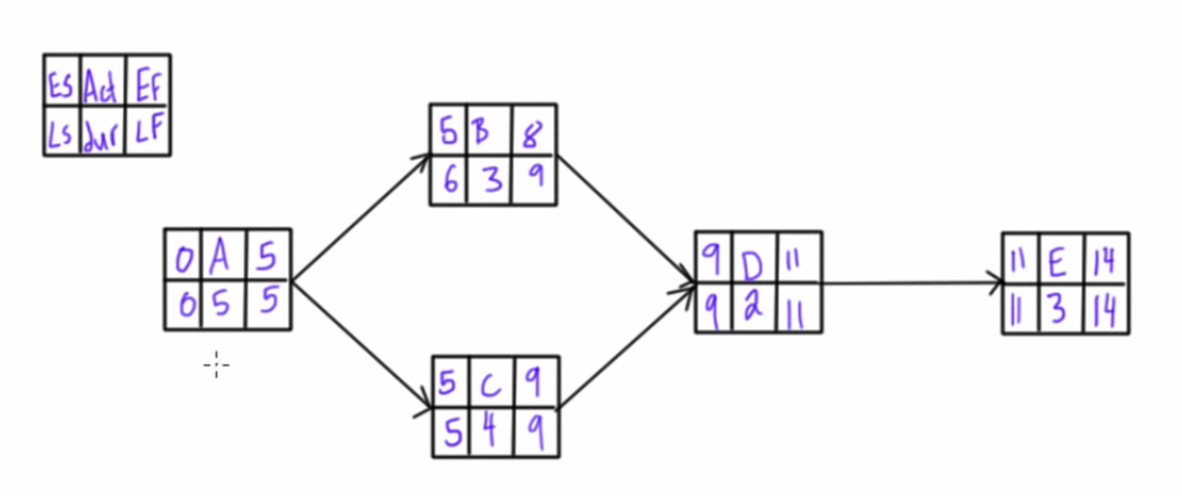

Slide 4
Float / Slack
In project management and network scheduling, total float (also known as total slack) represents the total amount of time that a particular activity within the project network can be delayed without delaying the project's completion date.
Total Float=Late Start−Early Start
Total Float=Late Finish−Early Finish
A positive total float indicates that there is flexibility in the scheduling of that activity, meaning it can be delayed without affecting the project's overall schedule
However, if the total float is zero or negative, it suggests that any delay in that activity would result in a delay in the project completion.
Total float is an important concept in project scheduling as it helps project managers identify the flexibility within the schedule and prioritize activities accordingly.

Slide 5
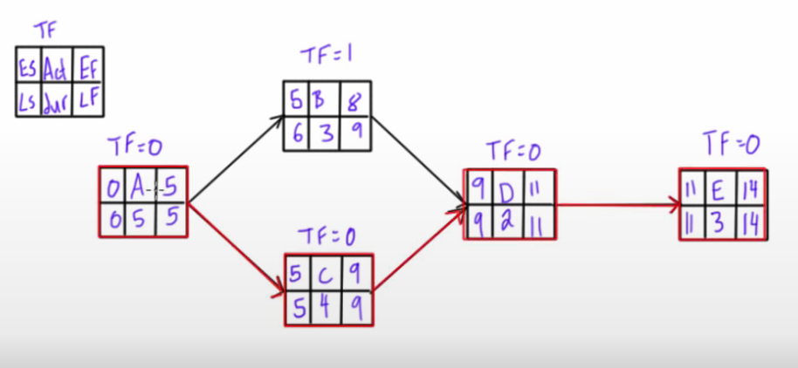

Slide 6
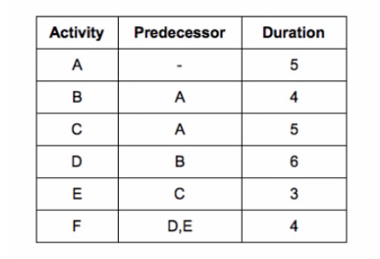

Slide 7
Free float
It represents the amount of time that a specific task can be delayed without delaying the start of the next dependent task.
In other words, free float is the amount of time an activity can be delayed without affecting the early start of any succeeding dependent activity.
Free Float= min ES of successors – ES of activity – Duration of activity
If the free float is zero, it means that any delay in the current activity will impact the start of the next dependent activity.
If the free float is positive, it indicates that there is flexibility, and the activity can be delayed without affecting subsequent activities.
FF<=TF

Slide 8
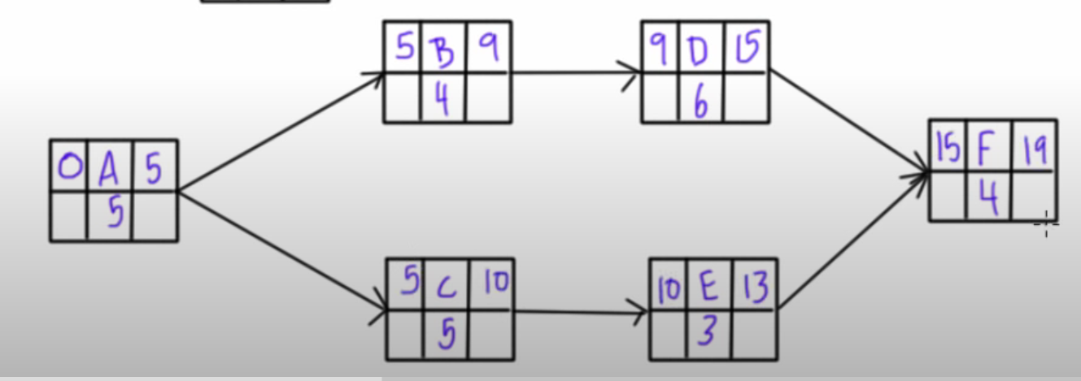

Slide 9
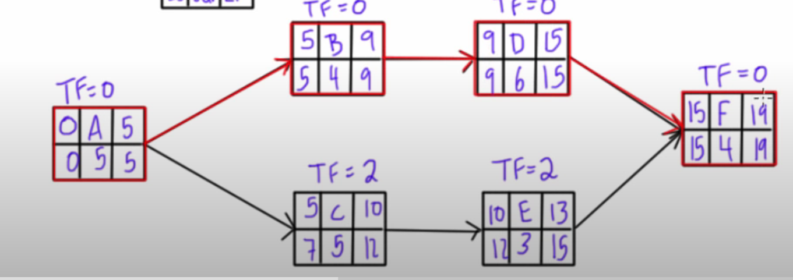

Slide 10
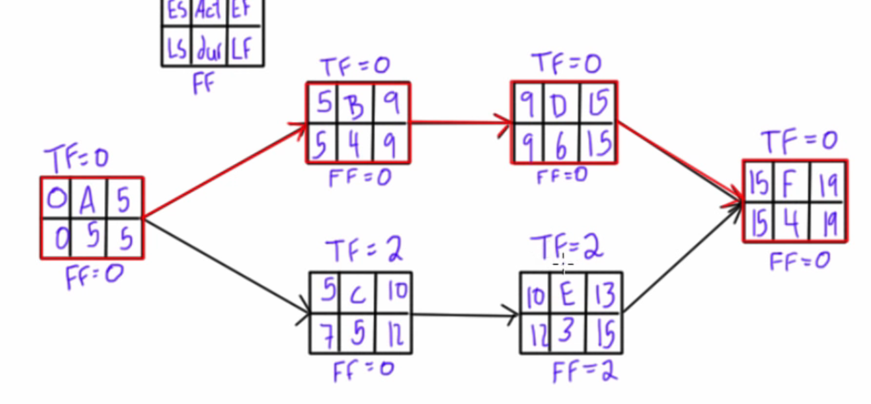

Slide 11
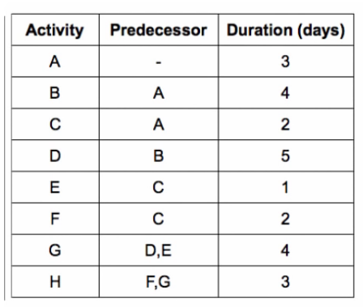

Slide 12
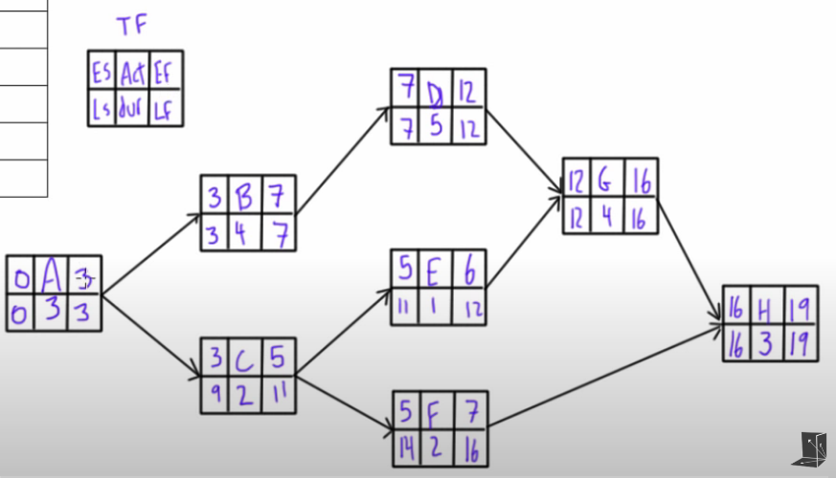

Slide 13
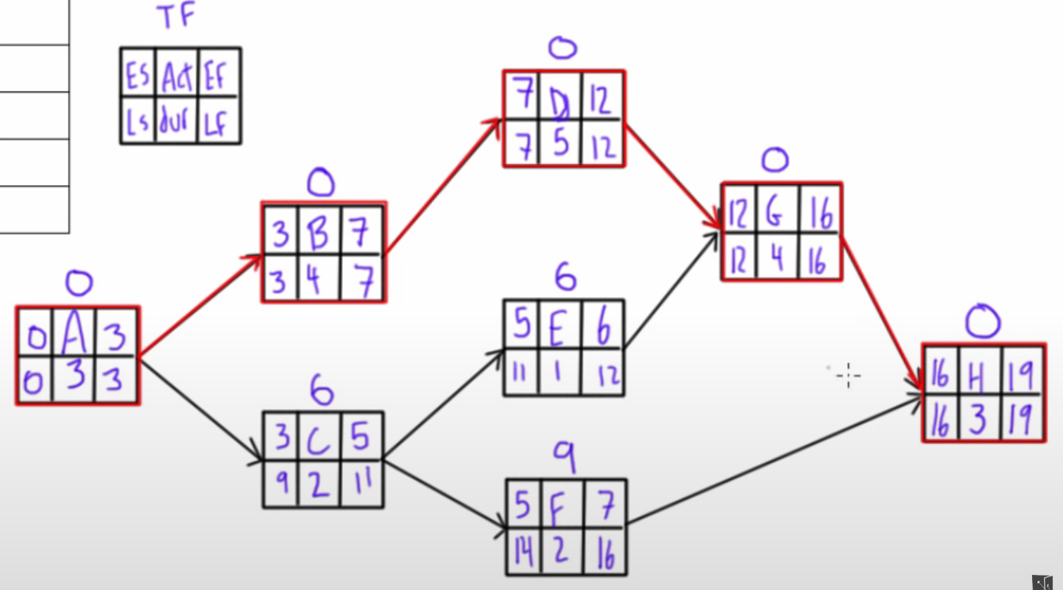

Slide 14
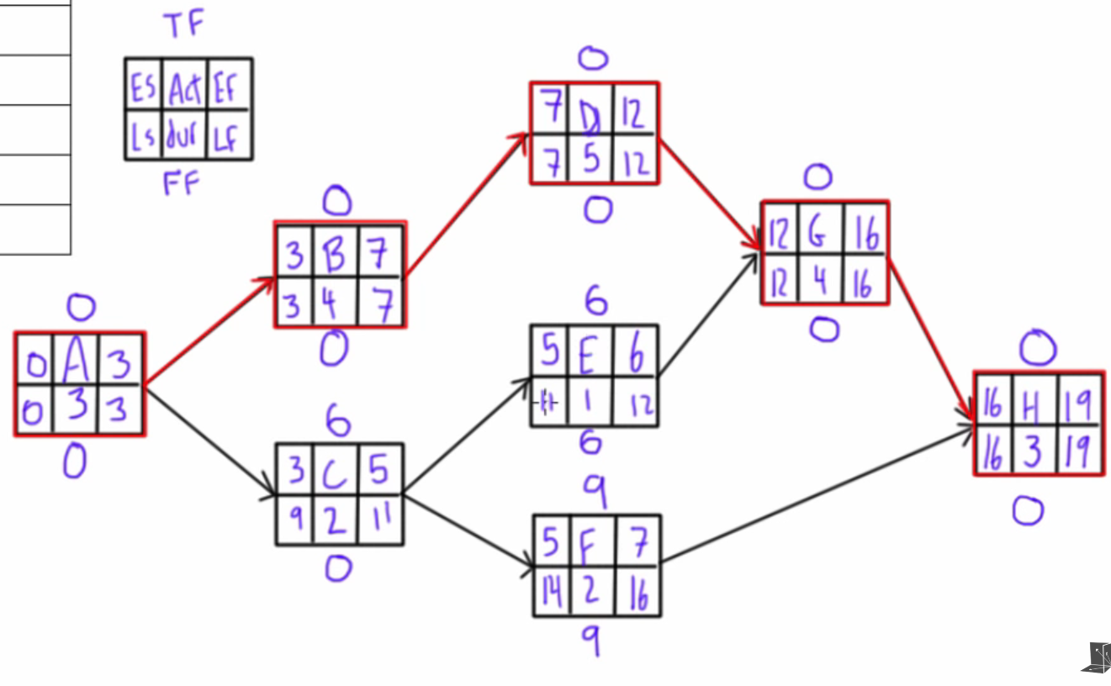

Slide 15
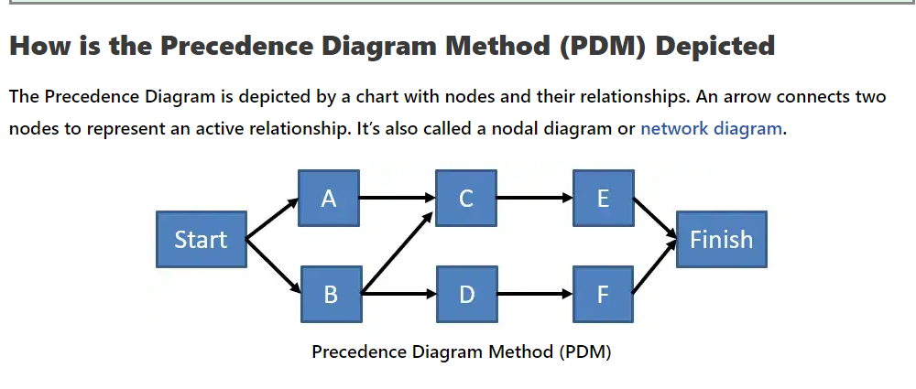

Slide 16
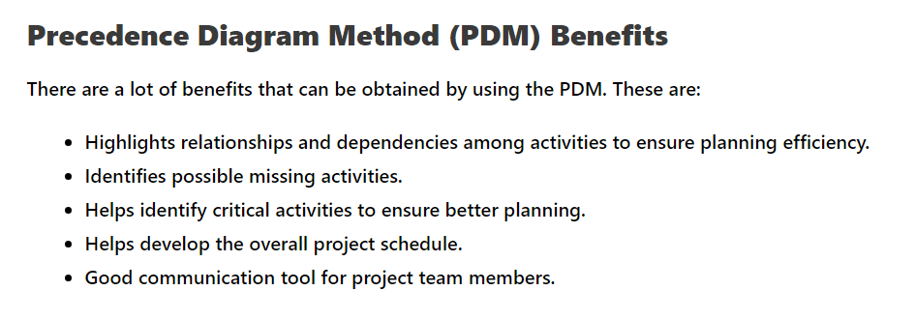

Slide 17
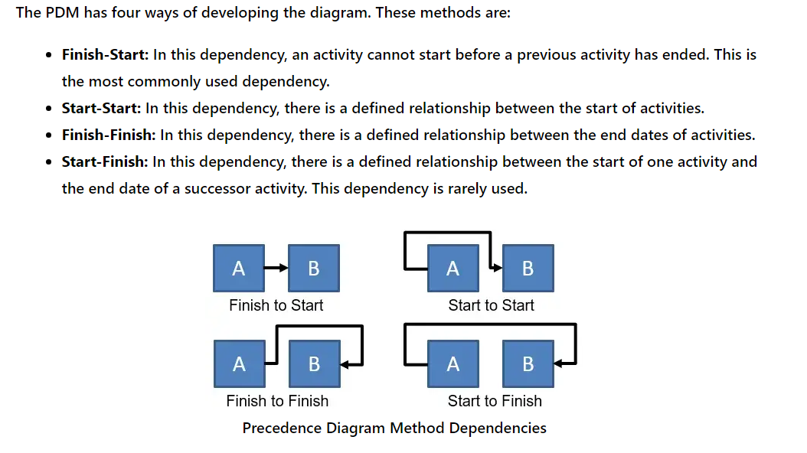

Slide 18
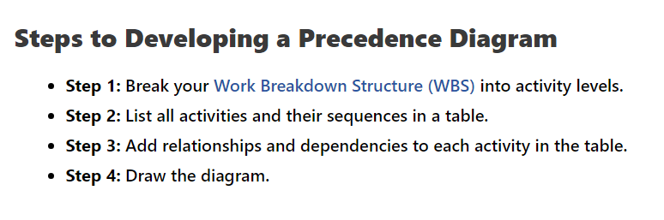

Slide 19
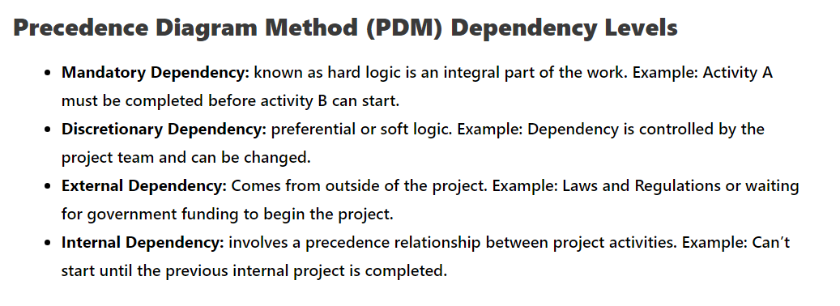

Slide 20
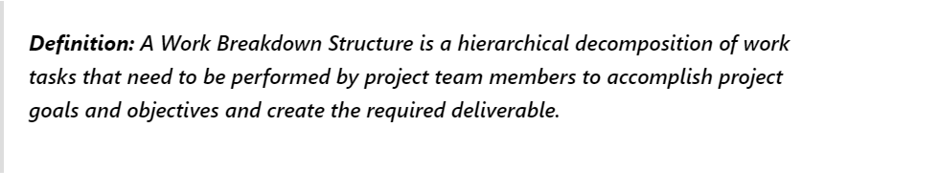
WBS

Slide 21
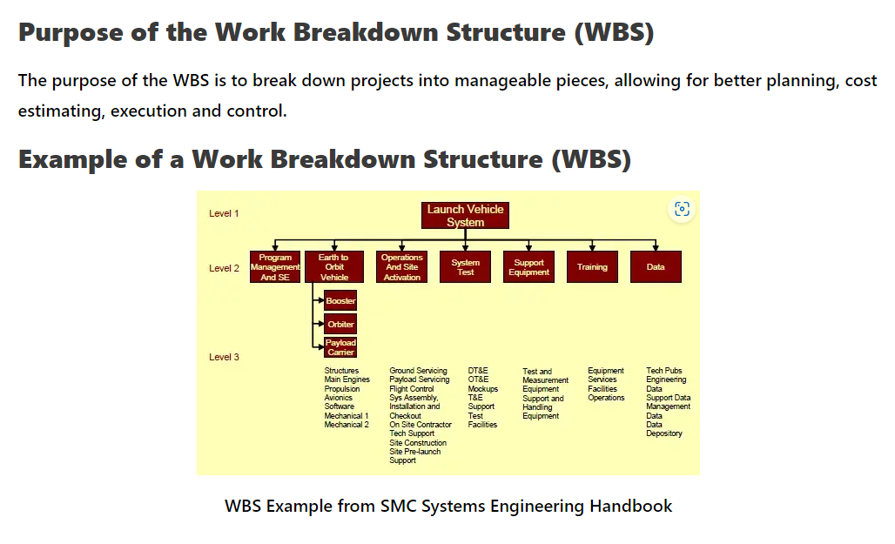

Slide 22
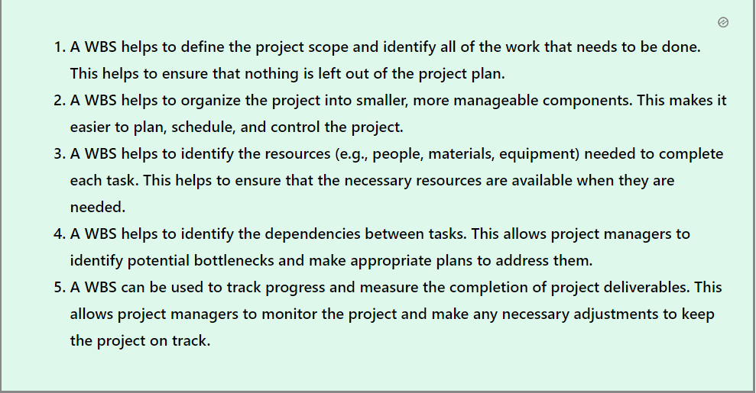

Slide 23
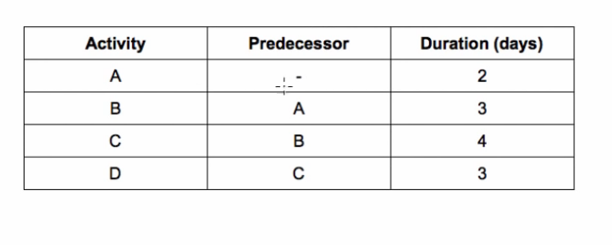
Gantt Chart

Slide 24
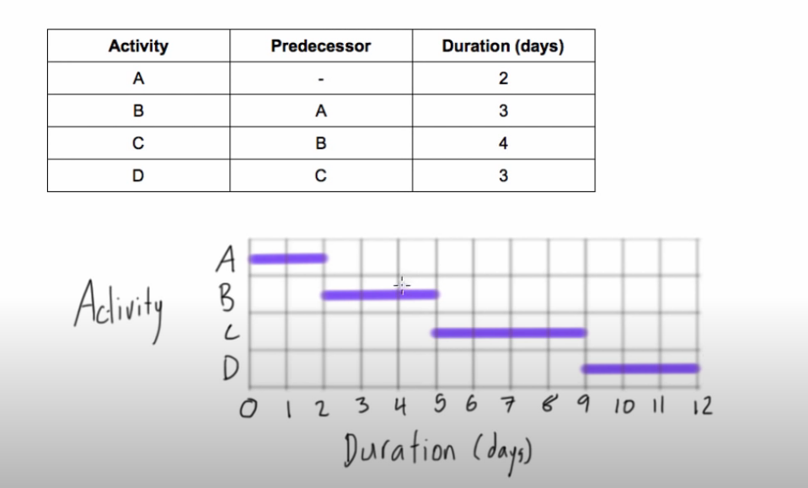

Slide 25
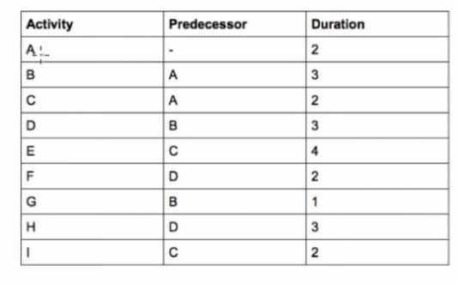

Slide 26
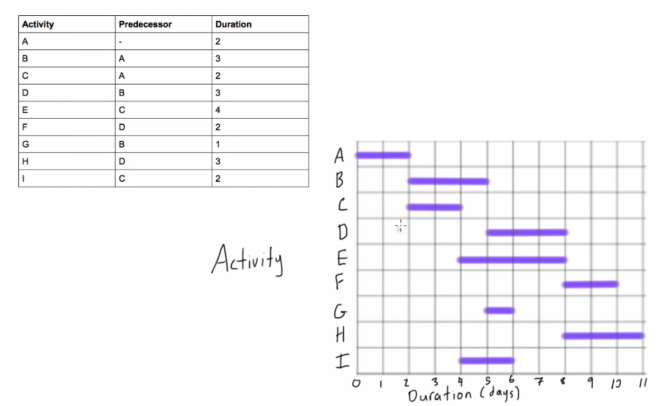

Slide 27
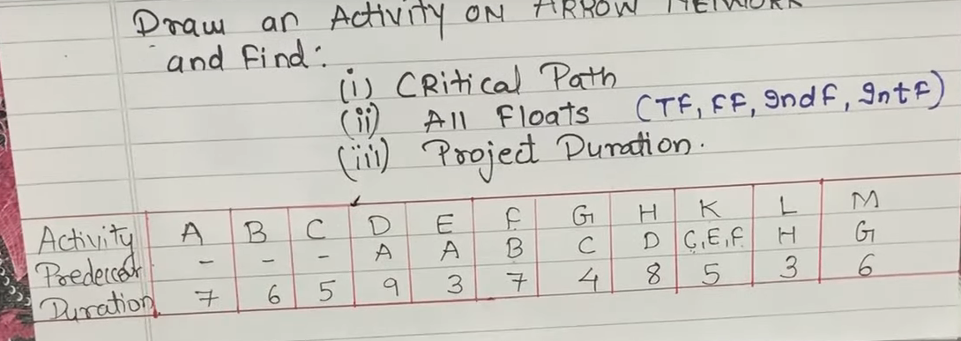
CPM Network Diagram

Slide 28
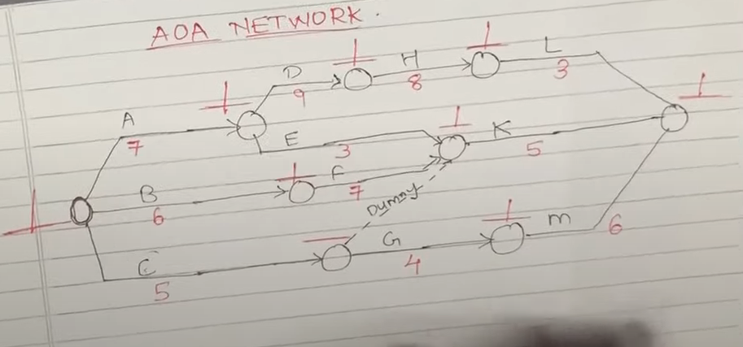

Slide 29
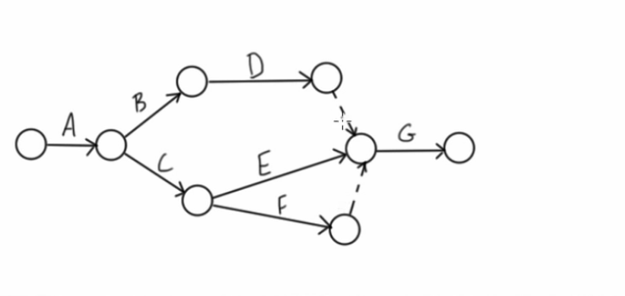

Slide 30
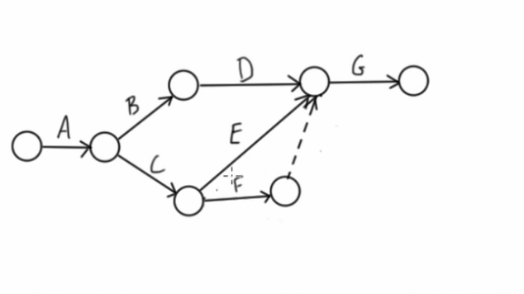

Slide 31
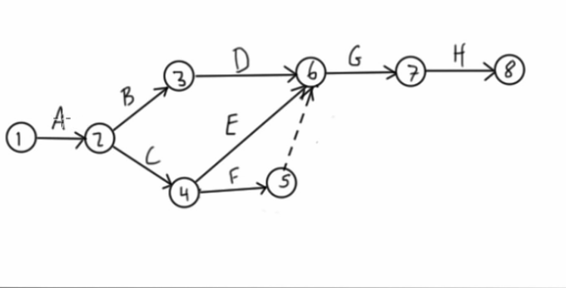

Slide 32
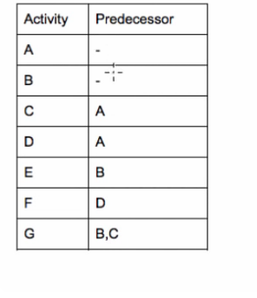
You can start and end on only single node.

Slide 33
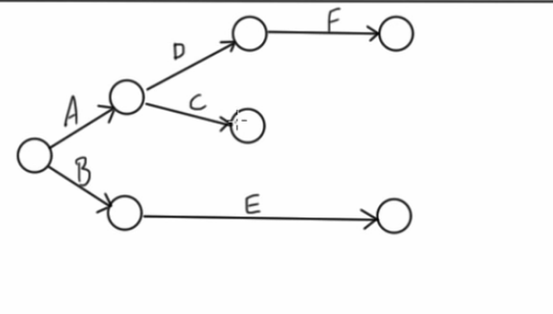

Slide 34
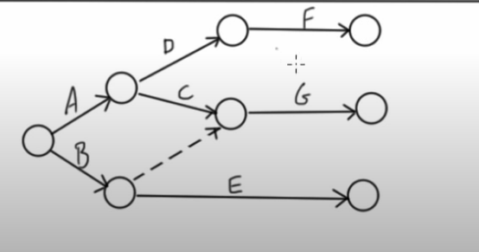

Slide 35
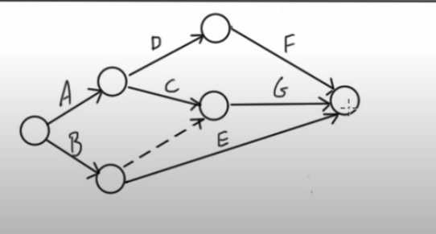

Slide 36
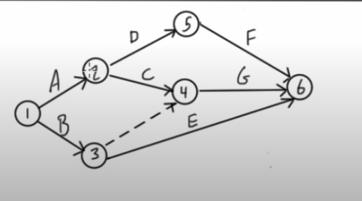

Slide 37
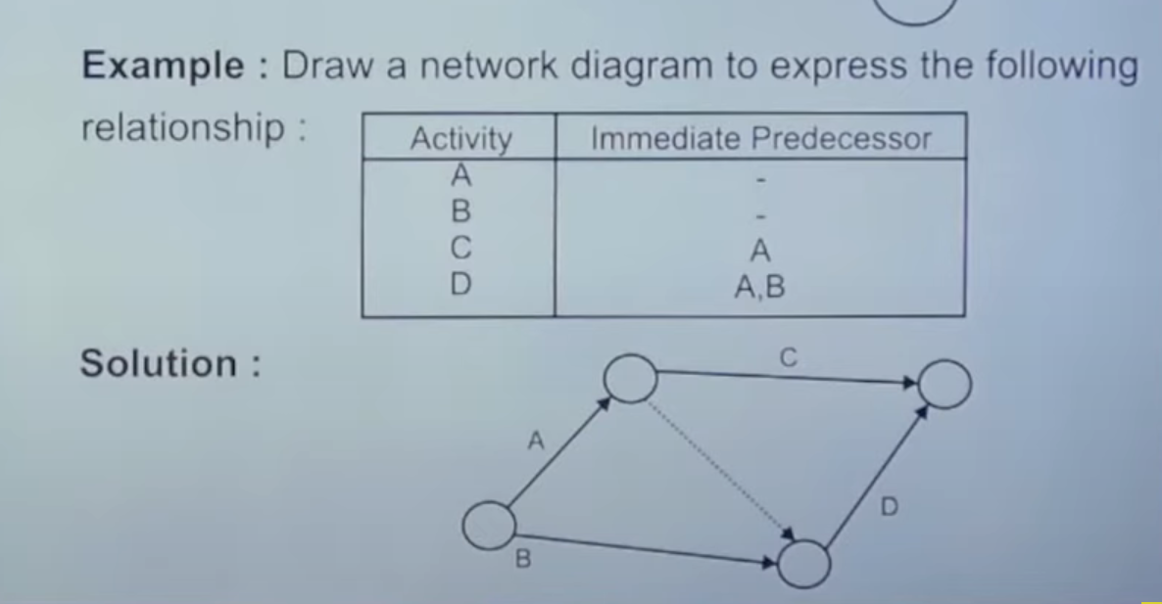

Slide 38
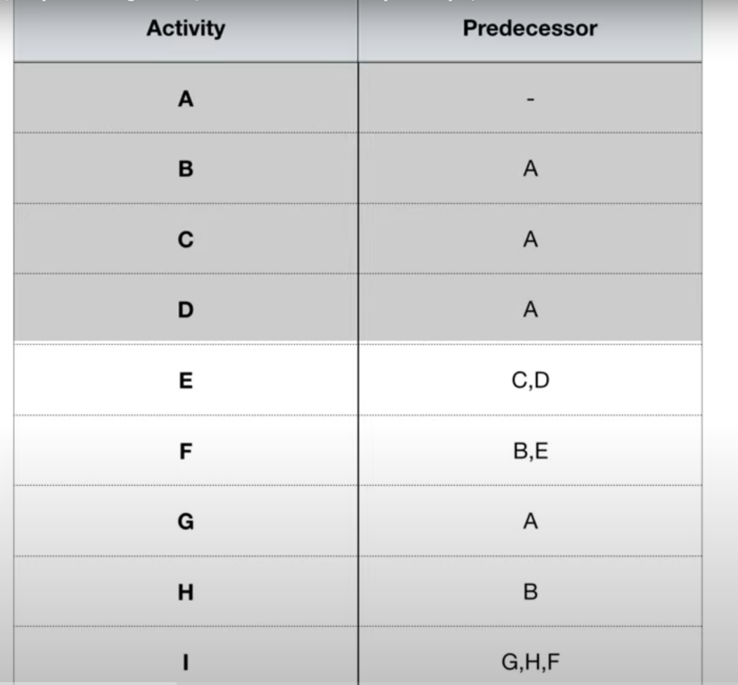

Slide 39
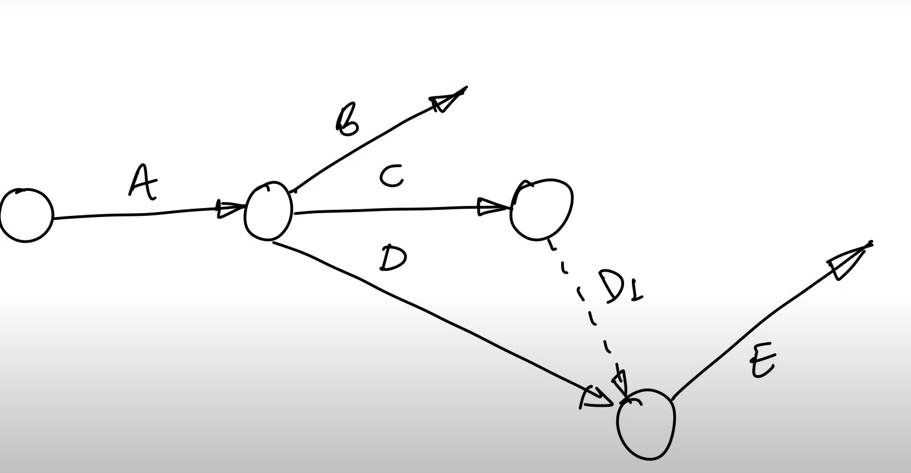

Slide 40
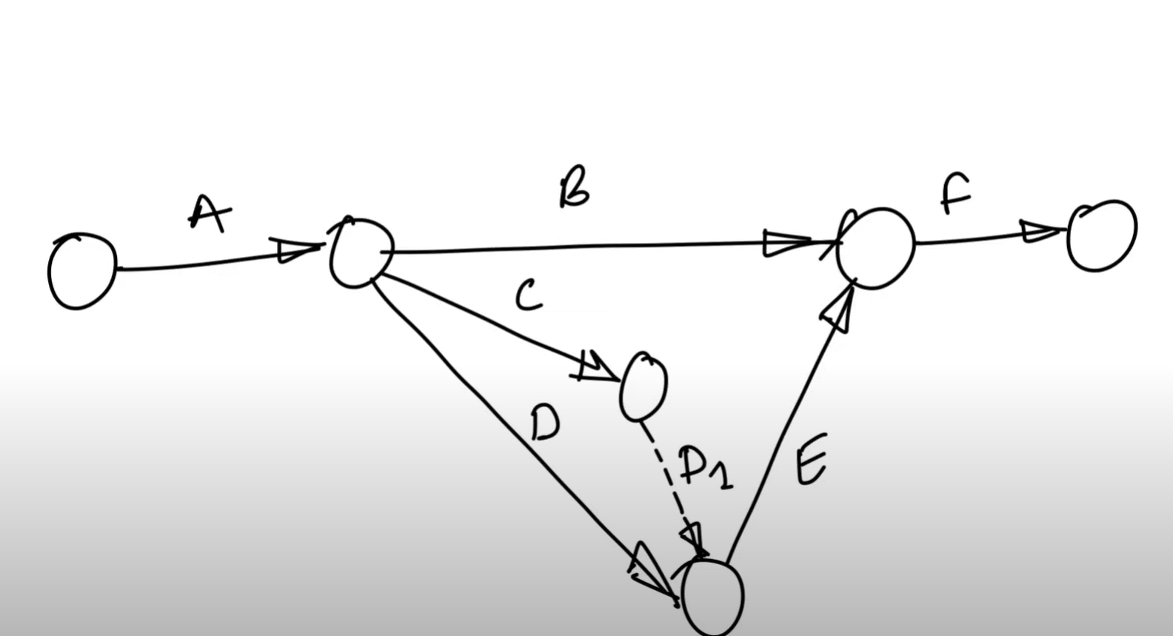
If tail events are diff, we can have same head event

Slide 41
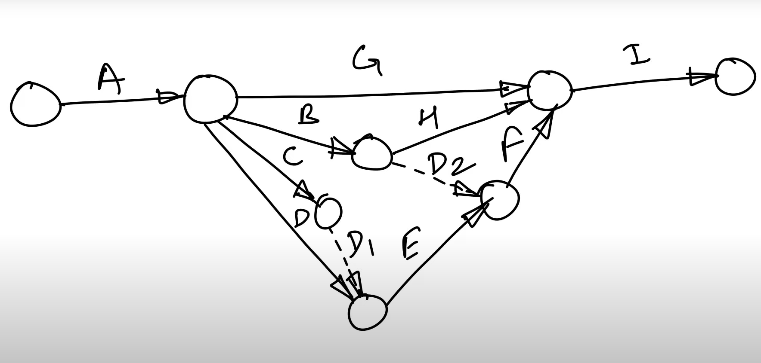

Slide 42
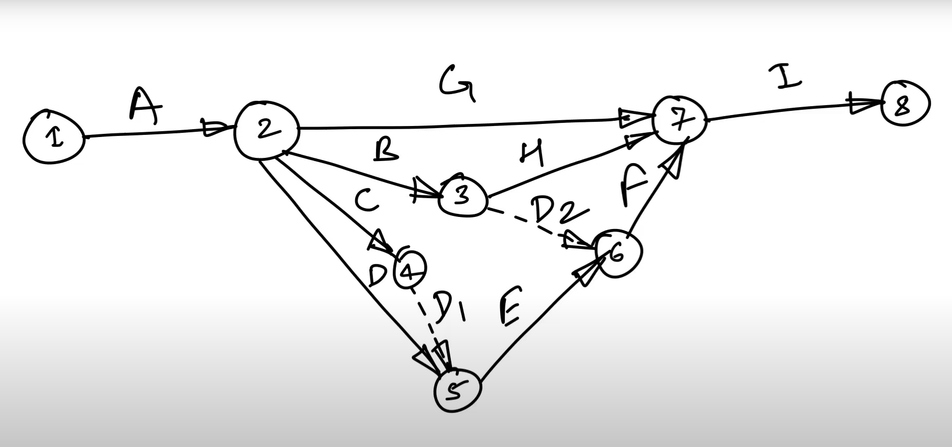

Slide 43
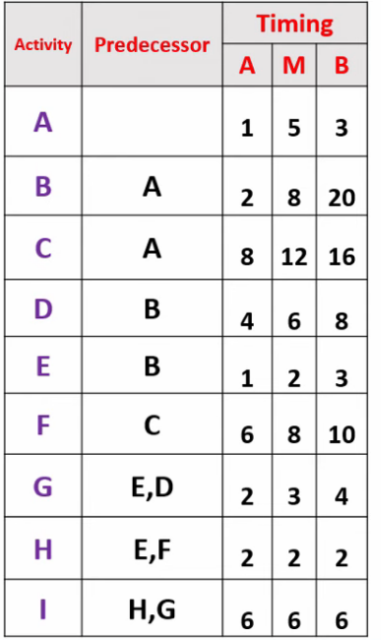
PERT – Program evaluation and Review technique

Slide 44
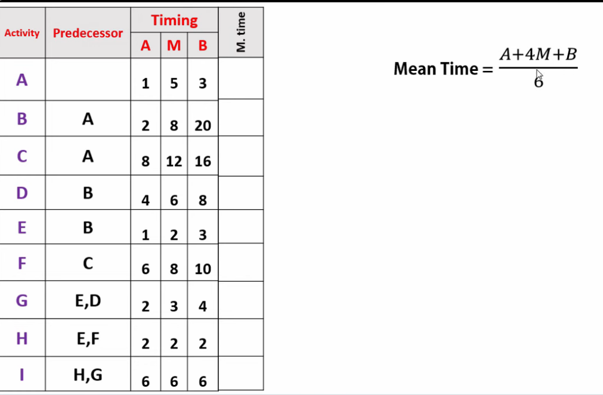

Slide 45
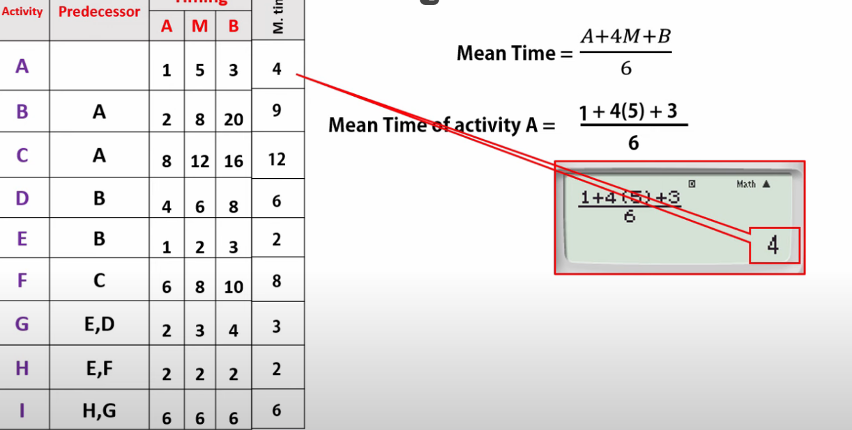

Slide 46
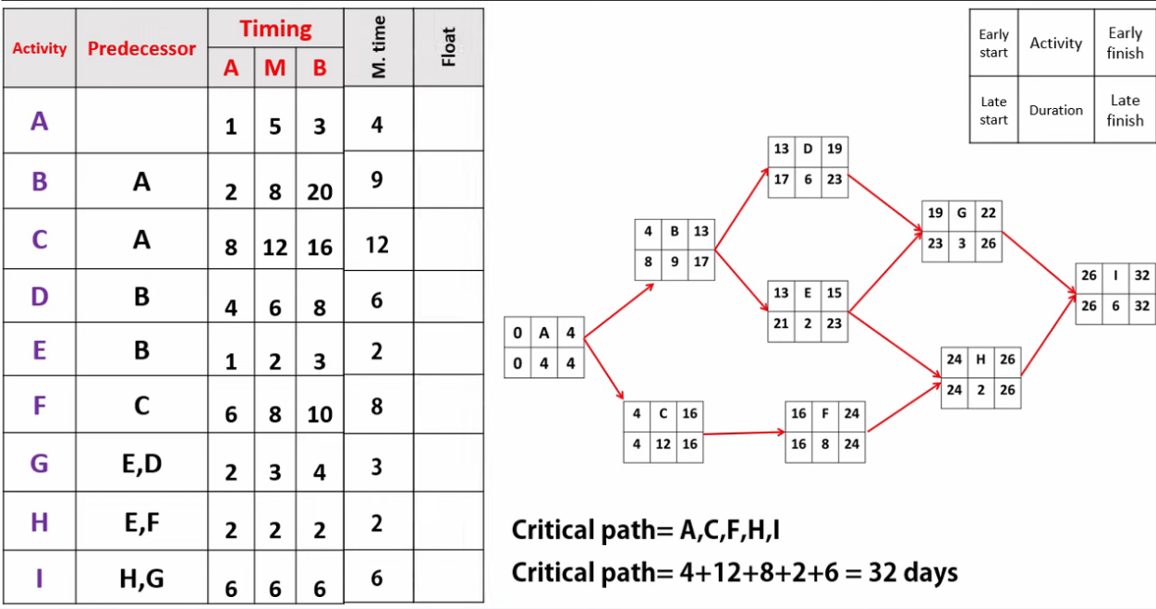

Slide 47
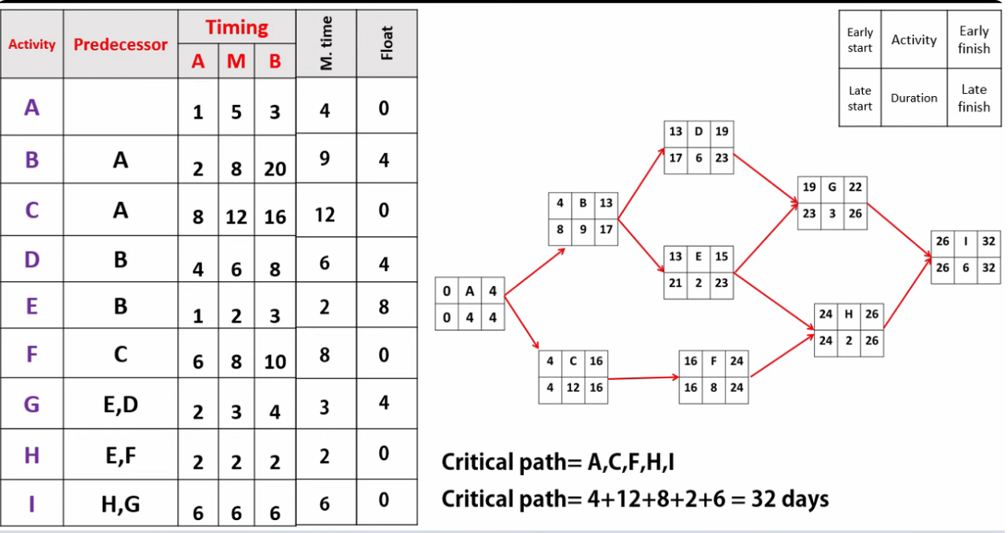

Slide 48
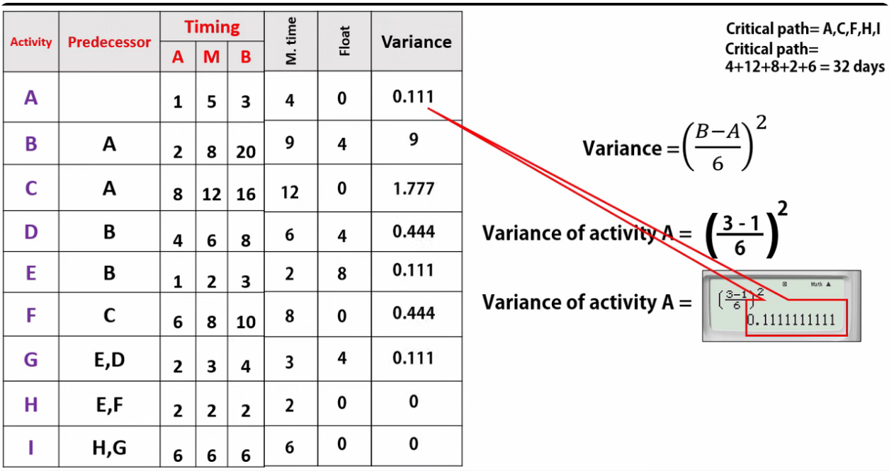

Slide 49
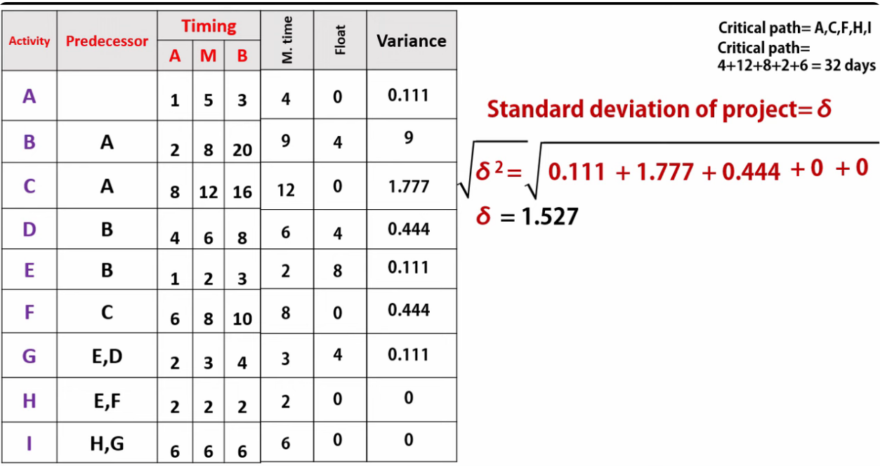

Slide 50
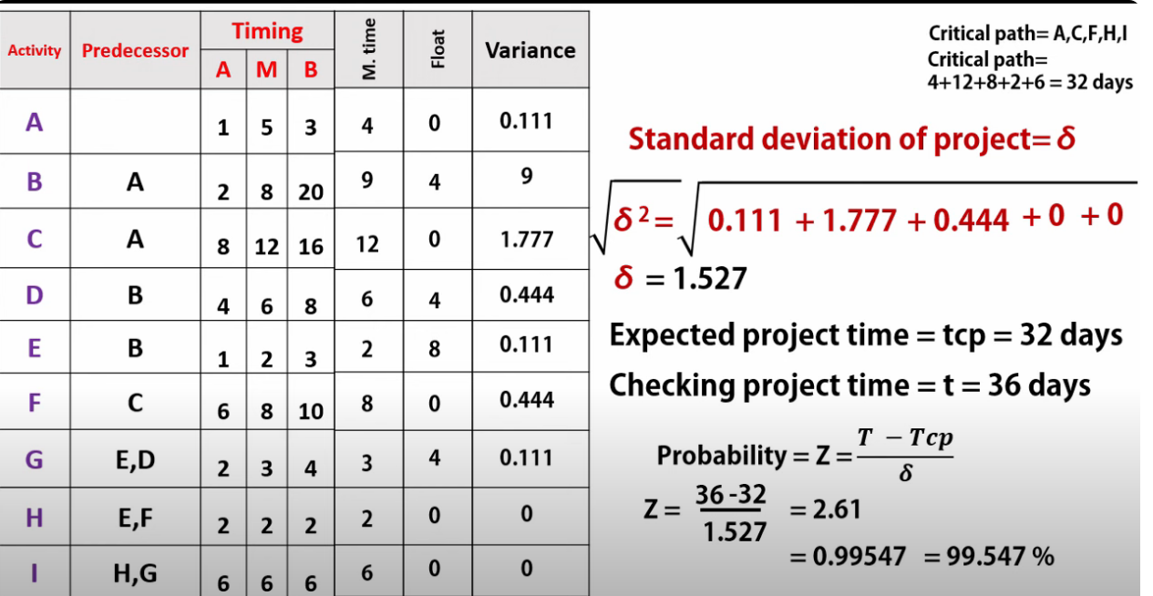

Slide 51
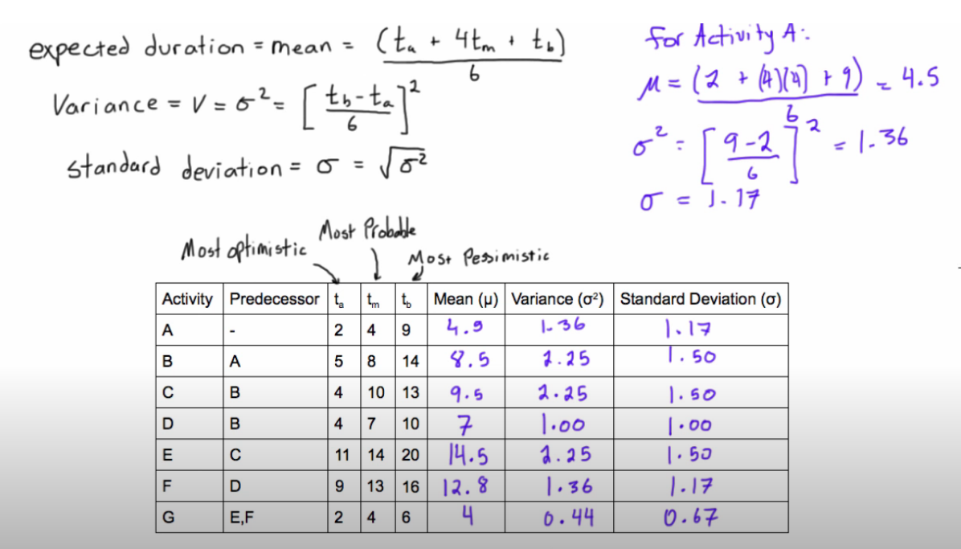

Slide 52
